Slide 1
Using Social Media to Assess Neighborhood Social Disorganization
A Case Study in the United Kingdom
Diogo F. Pacheco, Marcos Oliveira, Ronaldo Menezes
Florida Institute of Technology

Slide 2
Agenda
Introduction
Approach
Results
Conclusions

Slide 3
Introduction
Social disorganization
Crime
Social media as a proxy for society?

Slide 4
Introduction
Social disorganization
Crime
Social media as a proxy for society?
Twitter Football Social Disorganization Crime?

Slide 5
Approach

Slide 6
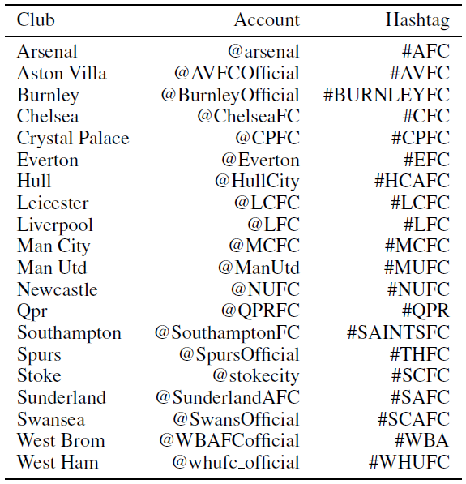
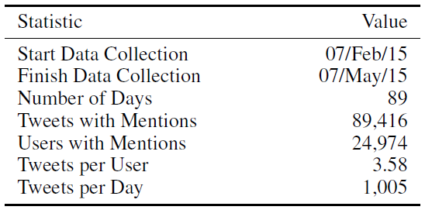
Approach
Datasets – Twitter

Slide 7
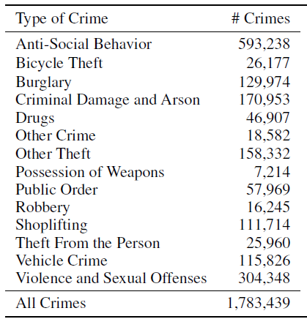
Approach
Datasets – Crime (data.gov.uk)

Slide 8
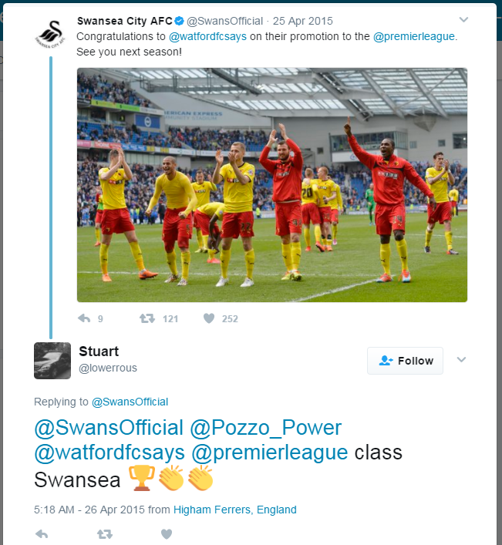
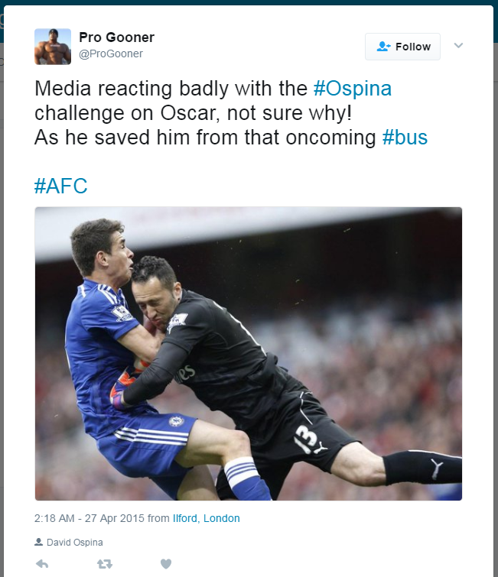
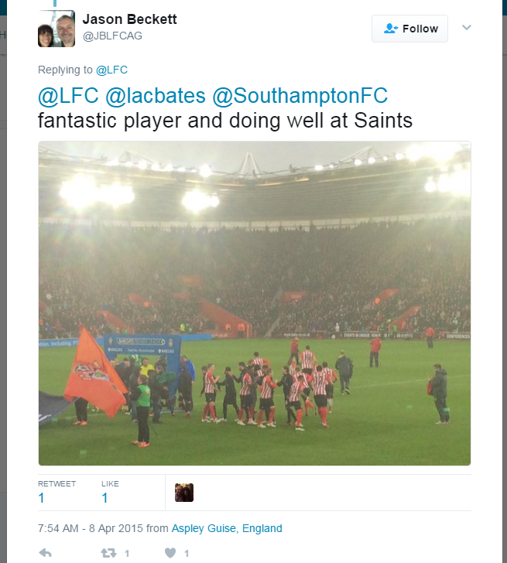
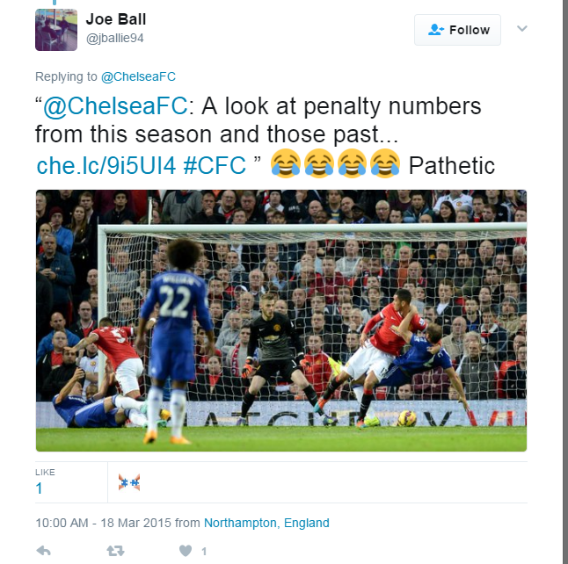
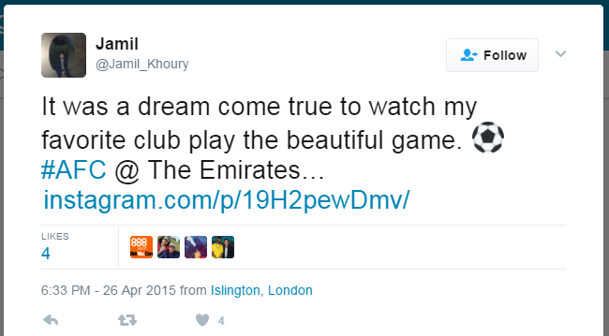
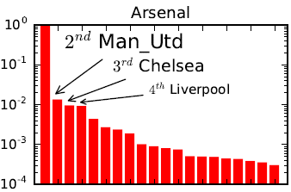
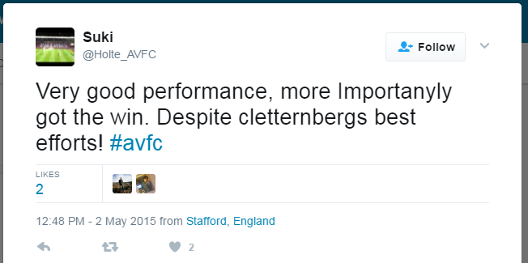
Approach
Characterizing users

Slide 9
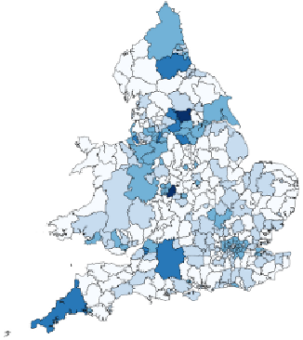
Approach
Characterizing users and regions
Global
1 charac. per user
Local
1 charac. per user and per region (LSOA)

Slide 10
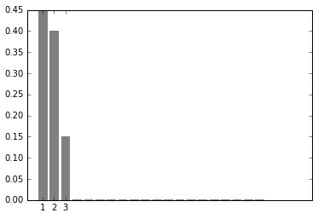
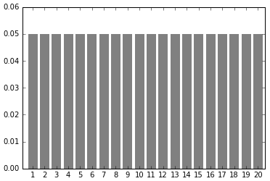
Approach
The Entropy of Football Supporters in a region
More clubs being mentioned, greater entropy.

Slide 11
results

Slide 12
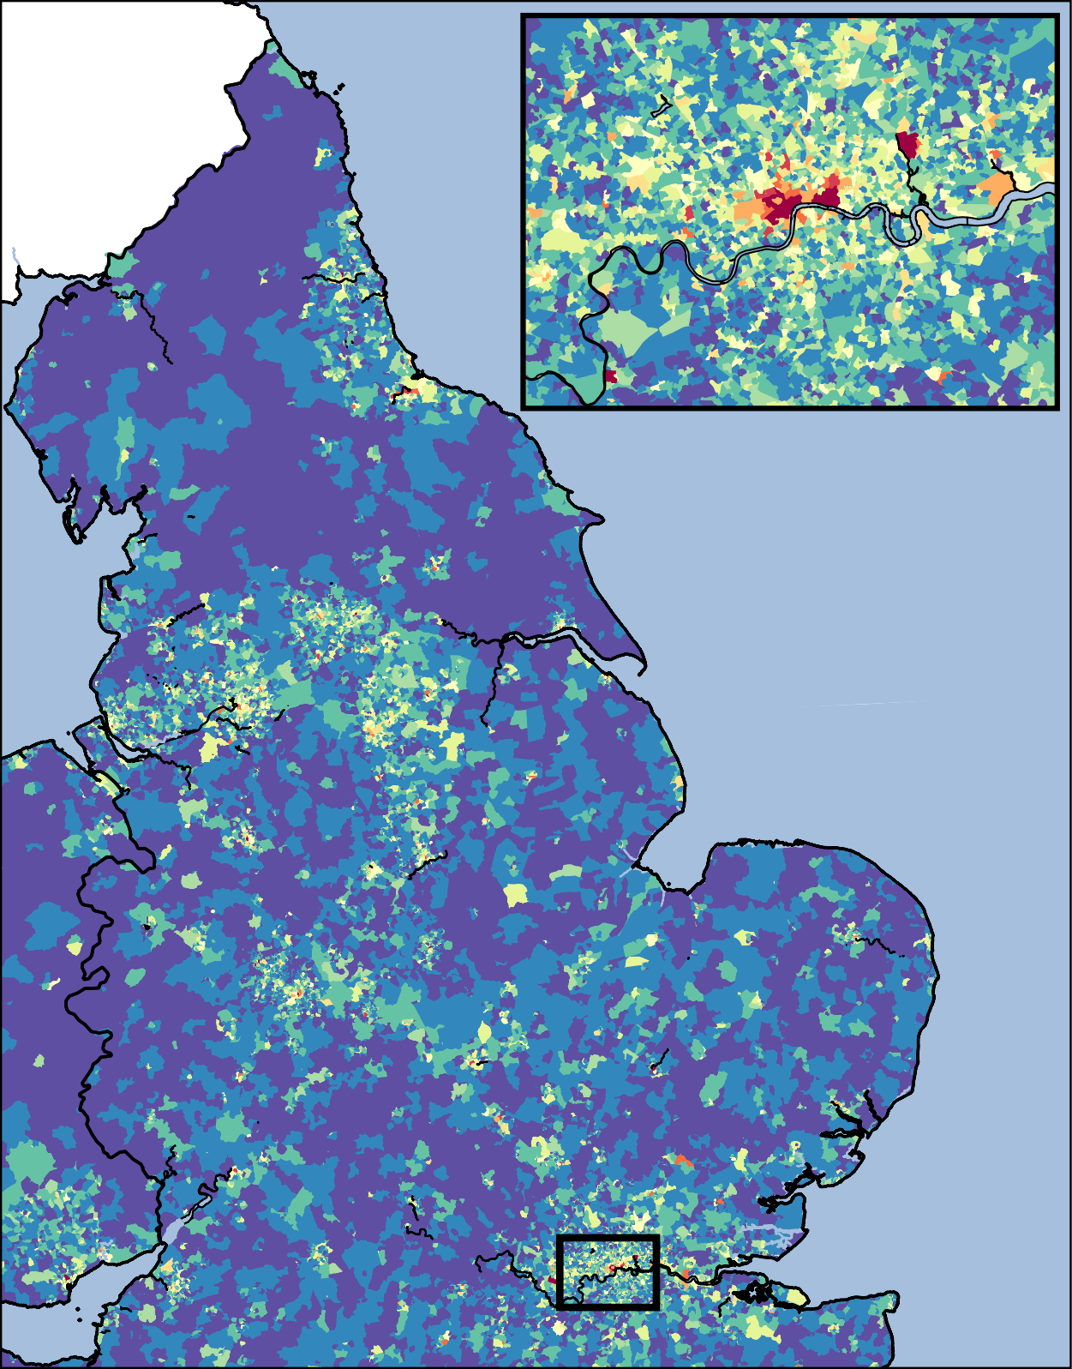
Results
Crime Concentration
High
Low

Slide 13
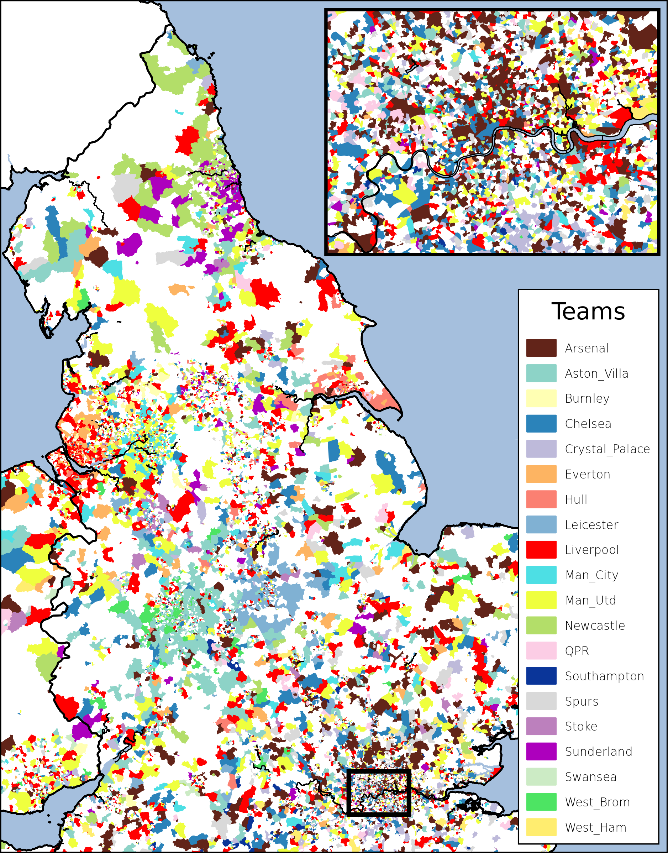
Results
Regions Characterized

Slide 14
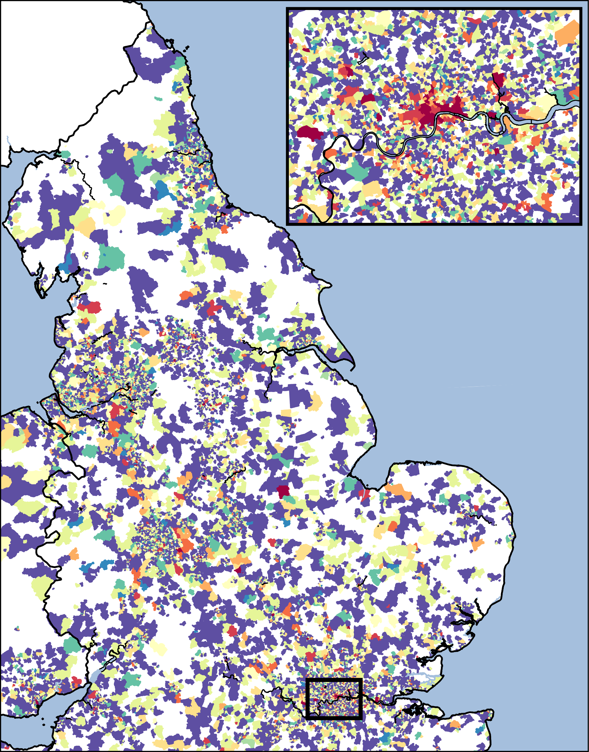
Results
Entropy of Supporters
High
Low

Slide 15
results
Partial Correlation (Crime,Entropy | Users)

Slide 16
results
Partial Correlation Analysis

Slide 17
results
Regression Analysis

Slide 18
conclusions

Slide 19
conclusions
We proposed a measure for social disorganization in a region using social media.
Significant correlation between:
#users and #crime
Entropy of supporters and crime
Partial corr, isolating #users (population)
Higher correlation in regions more disorganized and populated.
Regression models, significant coefficients regardless the type of crime, and 7x better with entropy.

Slide 20
Future works
Other datasets
Longitudinal data
Global vs. Local characterization
Twitter Football Social Disorganization Crime?
Language?
Real estate?
?
?

Slide 21
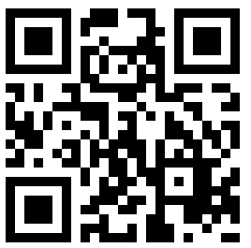
Using Social Media to Assess Neighborhood Social Disorganization
A Case Study in the United Kingdom
Questions?
Diogo F. Pacheco – http://diogofpacheco.github.io
dpacheco@biocomplexlab.org

